Slide 1




VMWARE BACKUP SOLUTION USING AZURE BACKUP
Presented By : Amit Gupta

Slide 2
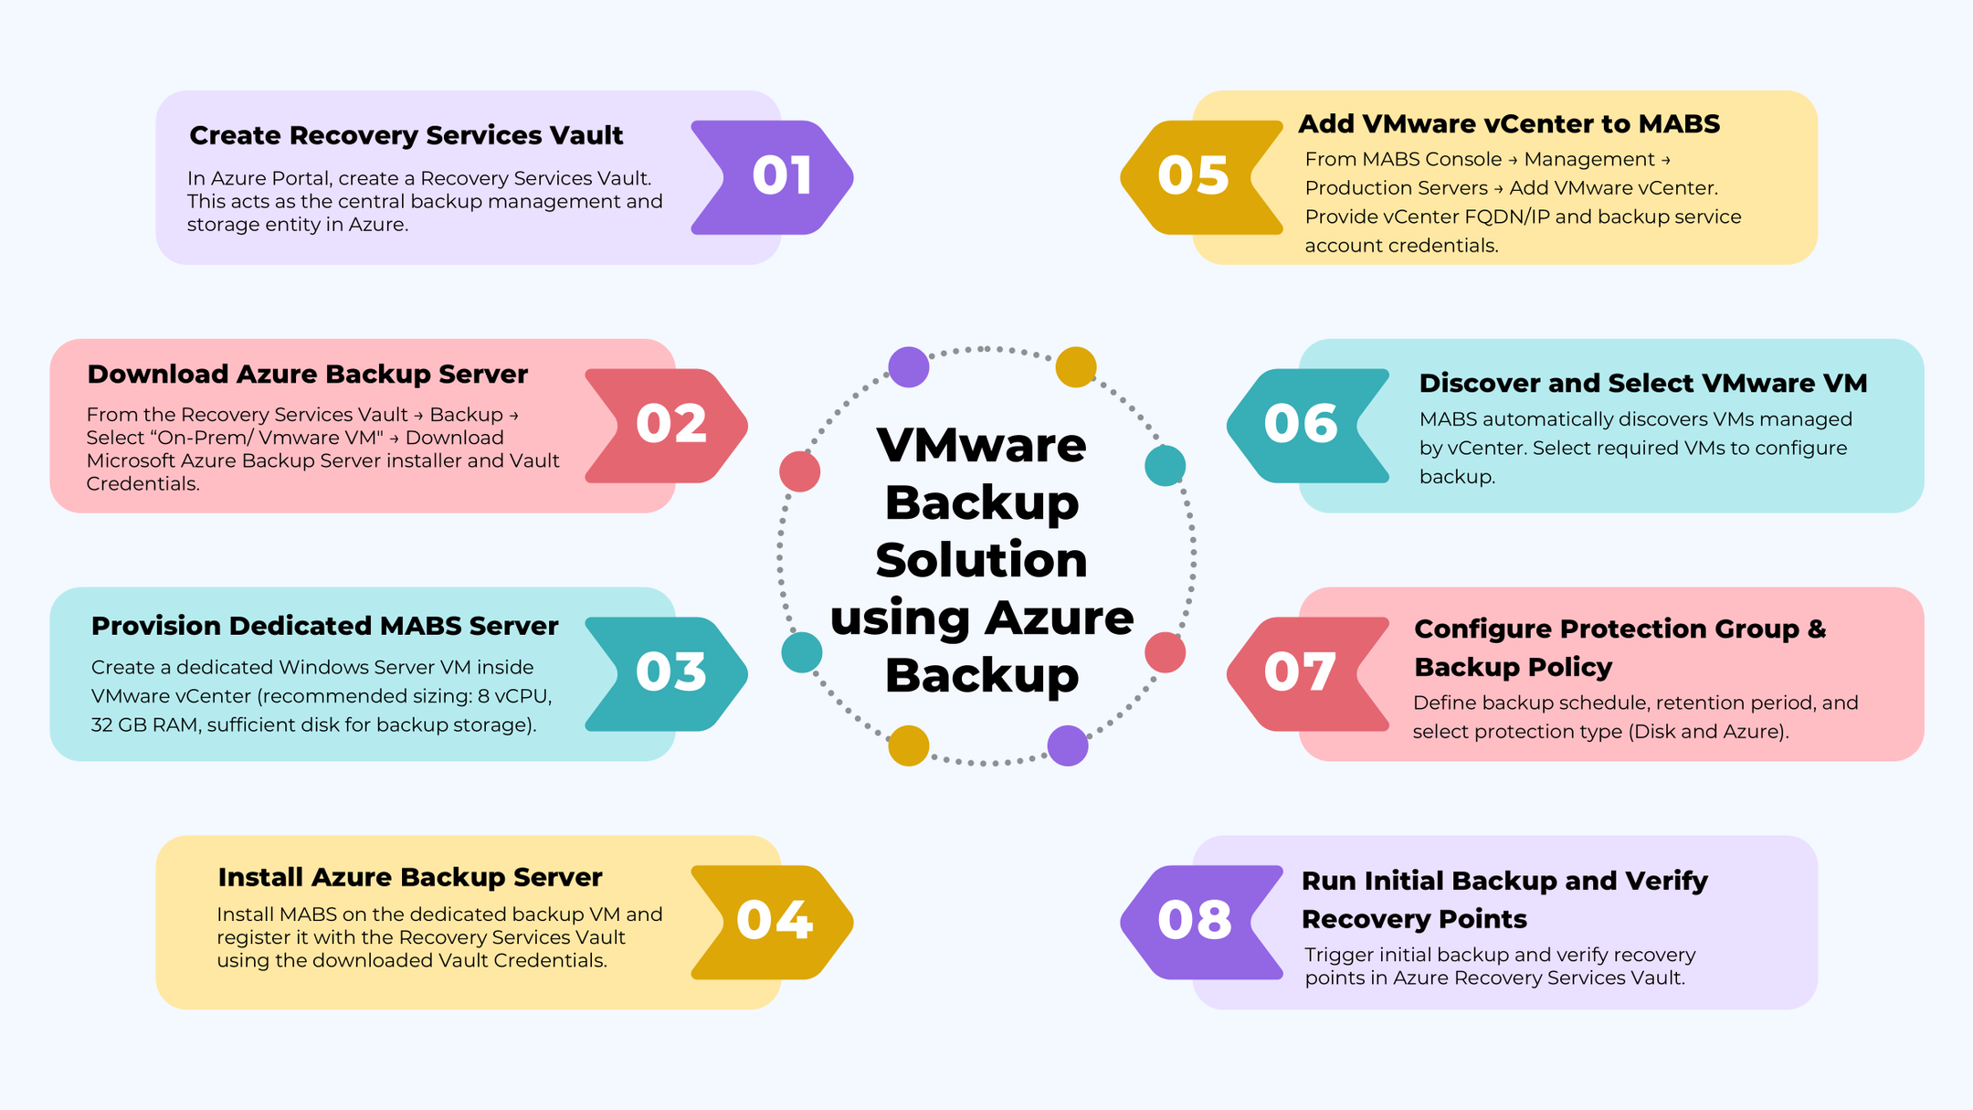

Slide 3
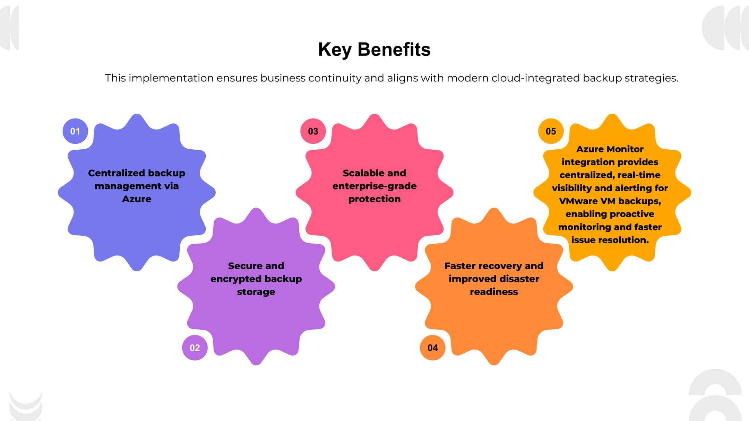

Slide 4
Recommendations
VM Configuration
Network Requirements
•CPU: Minimum 8 cores
•RAM: Minimum 32 GB
C Drive : 150 GB
•Disk: 1.5x protected data size
•Separate disk for backup storage
•MABS to vCenter: TCP 443
•MABS to ESXi Hosts: TCP 902
•MABS to Azure: TCP 443 outbound
•DNS resolution required
•Internet or ExpressRoute connectivity
01
02
Backup Policy Configuration
03
04
Assign role & Permissions
•Define protection groups
•Configure backup schedule
•Configure retention policy
•Configure disk and cloud protection
•Enable application-consistent backup
VM → Snapshot → Create/Delete
VM → Configuration → Read
VM → Provisioning → Read
DataStore → Browser

Slide 5
THANK YOU

